Slide 1
Assessing Small and Medium-sized Enterprises (SMEs) Financial Risk
Model applied: Binary logistic, probit and complementary log-log model
Stat 410 - Chi Nguyen

Slide 2

Why I chose this topic
I used to work at a startup, and this topic got me curious about what affects a small business’s financial health. I wanted to see if there’s a way to predict the risks that SMEs face.

Slide 3
Background
SMEs (Small and Medium-sized Enterprises) represent 99% of businesses in the EU and 99.9% in the US, which is crucial for the economy.
In 2024, SMEs contribute nearly 44% U.S GDP and nearly two-third, roughly 63% of new jobs growth in the U.S
Despite their importance, SMEs face barriers to accessing finance, primarily due to: such as high non-performing loans (NPLs), Limited capital reserves, Regulatory capital requirements, etc…
Economic factors like inflation and unemployment also impact SMEs’ financial health and access to funding, affecting their growth and stability.
This analysis uses a logistic model to assess key financial indicators - NPLs, total assets, inflation, and unemployment - for primary predictors of financial risk in SMEs.

Slide 4

Dataset
The dataset
acquired from PLOS ONE
with SMEs from 2014–2018
I examine the risk associated with SMEs, using Non-Performing Loans (NPL) as a key indicator of financial health.
>=15% as “High risk”
<15% as “No/Low risk.
The variables:
Non-Performing Loans (NPL): Indicates the percentage of overdue loans, a primary risk measure.
I set risk_indicator (to receive positive results for the output)
0 = High Risk (NPL >= 15%)
1 = No/Low Risk (NPL < 15%)
Unemployment Rate: Reflects economic conditions; higher rates can reduce SME revenue and increase default risk.
Inflation Rate: High inflation can raise costs, affecting SMEs' ability to service debt.
Total Assets (totass_wonorm): SME financial size, with larger asset bases suggesting more stability. (I scaled by dividing by 10,000 for analysis)

Slide 5

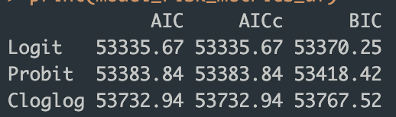
Choosing the model
From the R output, after comparing the AIC, AICC, and BIC values, the binary logit model has smallest values in all three criteria, and thus has a better fit

Slide 6

SAS code
SAS output

Slide 7

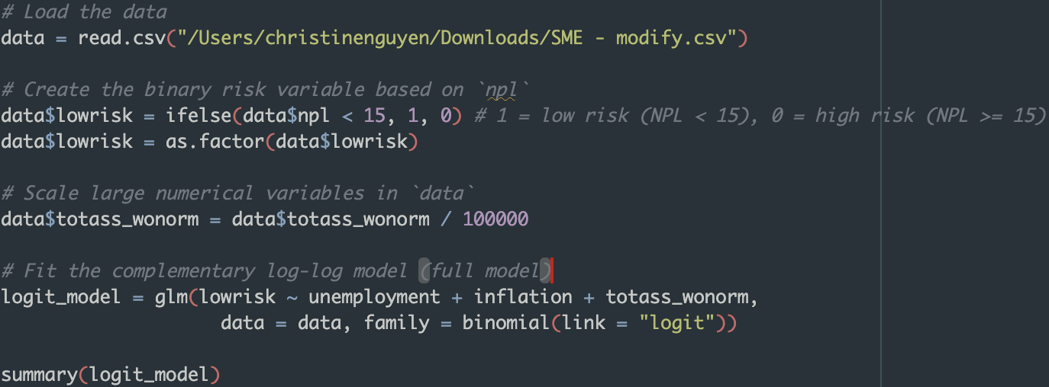
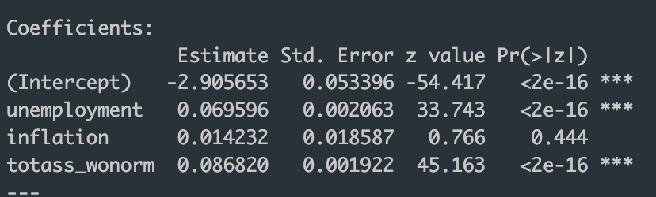
R code
I set risk_indicator
0 = High Risk (NPL >= 15%)
1 = No/Low Risk (NPL < 15%)
R output

Slide 8

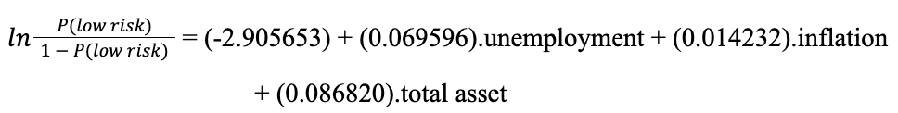
Interpretation
The fitted model:
At a 5% significance level,
Unemployment and total assets are the significant predictors.
Inflation is not the significant predictor (which make sense, since it may have fixed debt rate, gov support, etc...)
Interpretation of the estimated significant regression coefficients
Unemployment: For each 1% increase in unemployment, the estimated odds of an SME for “no/low risk" are exp⁡(0.069596).100% = 107.2075% of those for “high risk"
Total Assets: For each additional $10,000 in total asset, the estimated odds of an SME for “no/low risk" are exp⁡(0.086820).100% = 109.07% of those for “high risk"

Slide 9
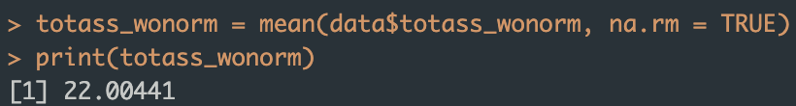
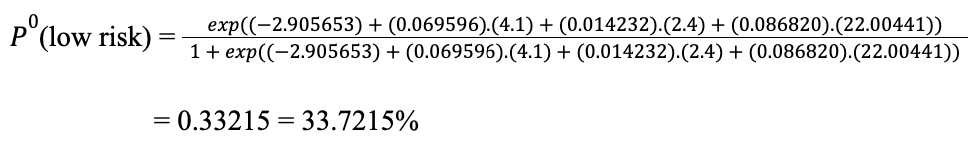
Prediction
The current value in the U.S:
Unemployment = 4.1
Inflation = 2.4
Mean Total Asset (computed by R) = 22.00441
Compute by hand:

Slide 10

SAS code _ Prediction
SAS output

Slide 11

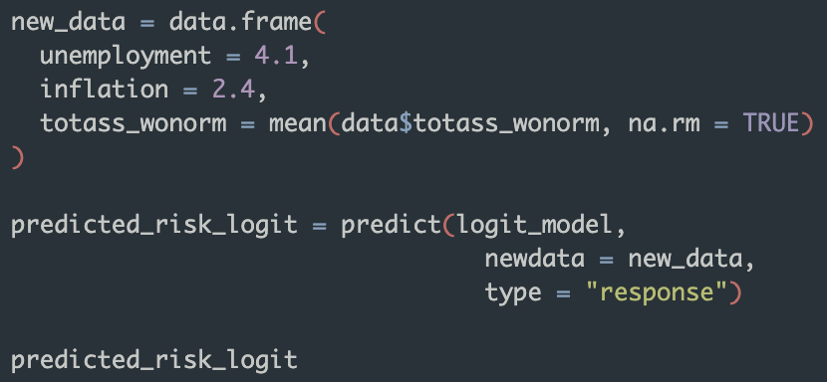
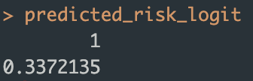
R code _ Prediction
Conclusion:
Similar results when computed by hand, R and SAS.
For an SME with:
Total assets: $2,200,441 (scaled back by x10,000)
Unemployment rate: 4.1%
Inflation rate: 2.4%
The probability of having low/no risk (NPL < 15%) is 33.72%.
This means there’s a 33.72% chance the SME will have no or low risk, and consequently a 66.28% chance of being classified as high risk.
R output

Slide 12
THANKS! DR.OLGA & STAT 410 CLASSMATES

